Slide 1
The Map of Quantum Comping

Slide 2
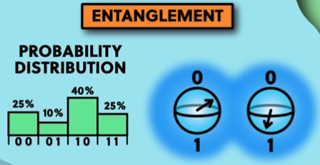
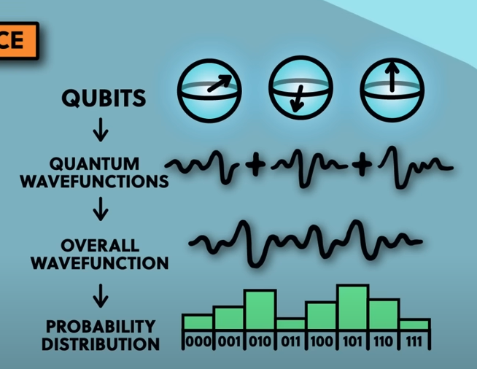
Introduction
Qubits can be in a huge number of states at the same time where classical computing can be in one state at a time
3 Terms
  Superposition
    A combination of states of 0 and 1
    Can be in a million states at the same time until it measured
  Entanglement
    The Qubits can be part of one large quantum state together.
    Calculate the probability distribution of all possible states
    Change direction of the arrow on one Qubit it changes the probability distribution for items
  Interference
    A Qubit is described by a quantum wave function
    When many Qubits are entangled their wave functions are added together in an
    overall wave function
    The wave can
      constructively Interfere to make a bigger wave
      destructively interfere to cancel each other out
    Interference is adding the wave functions
    The Overall Wave Function set the different probabilities of the different stats

Slide 3
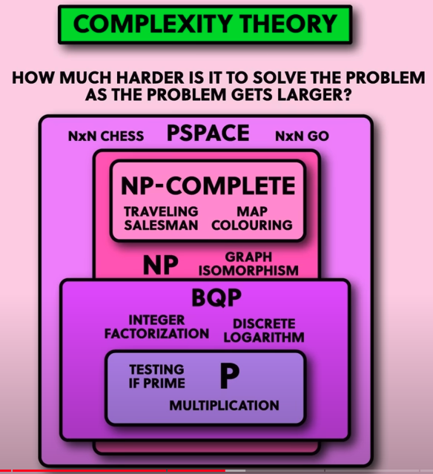
Quantum Algorithms
Shor’s Algorithm
  Factorization – Given a number what are factors.
    No efficient classical algorithm for finding large numbers
    Use factors of large numbers for internet encryption , secure websites
    and bank accounts
  Polynomial
  As of 05/27/2024 – Quantum computers are not able to run Shor’s Algorithm
Quantum Complexity Theory – How much harder is it solve the problem as the
problem the larger it gets
  P is easy to solve
  BQP – Efficient for Quantum Computer
Grover’s Algorithm – Search unstructured list of data faster than the best
algorithms in classical computing
Can simulate a quantum computer on a classical computer, but gets harder with increasing
number of qbits you are trying to simulate
Applications
  Quantum Simulation – Simulating chemical reactions or electronic properties
  As they involve and get larger will be able to solve more chemical reactions to improve their efficiency
  Other uses are improving batters, better catalyst for fertilizer production, drug development and new chemicals, will need more QuBits to solve these problems

Slide 4
Quantum Algorithms
Other areas
  optimization problems
  machine learning and AI
  Weather Forecasting
  Financial monitoring

Slide 5
Models of Quantum Computing
Gate Model
  QuBits are entangled with each other
  Gates perform operations to change the state without measuring them
Measurement Computing ( One Way Quantum Computing )
  Set up an initial entangled state and then measure the QuBit one by one
  Equivalent to the gate model
Adiabatic Quantum Computing
  Every system moves toward the lowest energy state
  Structure the problem in such as way
  Energy landscape where each point is an output
  Can be converted to and from the gate model
Quantum Annealing
  Energy minimization, but not universal ( cannot be convert to Gate Model or Measurement Computing )
  Does not have the full degrees of freedom to represent any quantum state as the other models do.
  Can solve Optimization Problems and Quantum Simulation
  Stepping Stone to building a adiabatic Quantum Computing

Slide 6
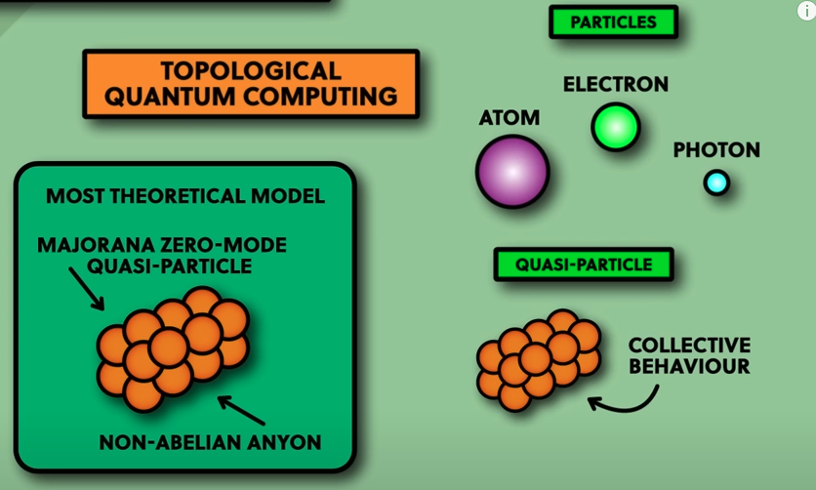
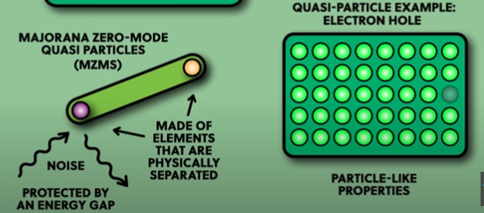
Models of Quantum Computing
Topological Quantum Computing
  create from the collective behavior of many particles together
  Have particle like properties despite being real
  Electron Hole – Treat it like a particle with particle like properties
    Can have the characteristics of its neighbors ?????
  Advantage – More stable than other QuBits since they are physically
  separated.
    Main source of fail in quantum computer is noise which comes
    from rouge forms of energy coming into the Quantum
    Computer making the QuBits drift away
    Protected by an energy Gap

Slide 7
What to Build Qubits from
Build from
  Atoms
  electrons
  photons
  Bulk Quantum Systems
To build a QuBit you need a two level quantum system to build 2 binary states
Properties
  spin
Obstacles
  Hard to control quantum since any contact with the outside word the information will leak away – decoherence
  Shield from any kind of noise ( cosmic rays, radiation, heat, particles )
  Will decoherence and noise ruin anything
  Quantum Error Connection – To make Fault Tolerant Quantum Computers
    Use many entangled QuBits together to produce one perfect QuBit
    Estimate on how many to group together -- 100 to 1000 to make 1 Fault Tolerant

Slide 8
What to Build Qubits from
  Scalability
    For each QuBit need a bunch of wires –
      Readout Wire,
      Connecting wires to other QuBits
      Control Wire
    As the number of Qubits the amount of wire you need increases linerally
Physical Realizations
  Supper conducting Quantum Computers
  Made from superconducting wires with a break in the super conducter called a Joseph Junction
  Transmon – 2 Energy System ( Frequency of Charge Oscillation – Copper Pare) and can use magnetic flux or superconducting phase

